Slide 1
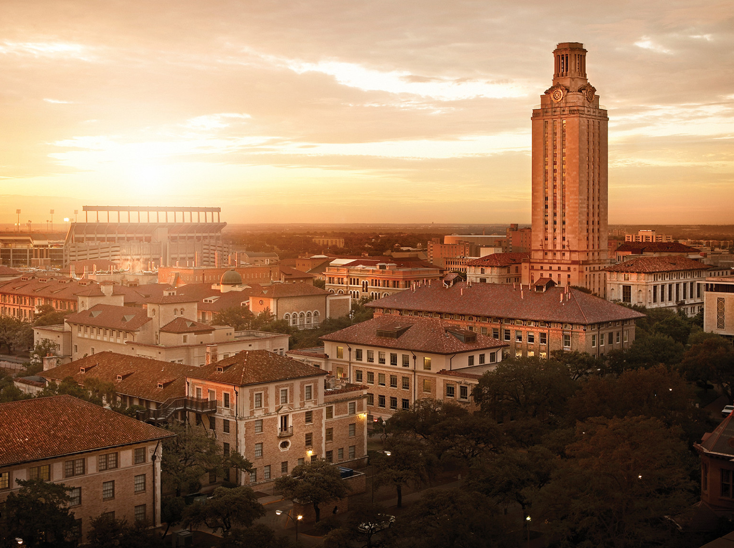
Better Serum Half-life of engineered Fc variant, DHS
Chang-Han Lee
George Georgiou Research Group
University of Texas at Austin

Slide 2
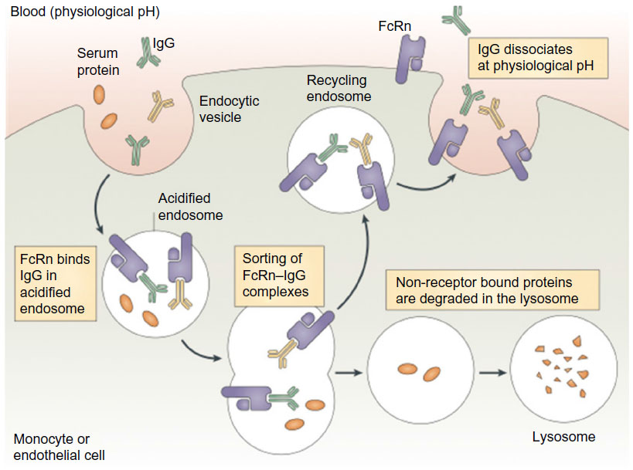
FcRn mediates bidirectional transport and membrane recycling of IgG
Step 1. Pinocytosis
Why?
1) limited expression level of FcRn on the surface (Ober et al., 2004 JI, Sally Ward group)
Extremely low affinity of IgG to FcRn at pH7.4
Step 2. Acidification of endosome and interaction of FcRn and IgG (Highly localized FcRn in early endosome).
Serum IgG vs. “therapeutic (injected) IgG”
: Competition for FcRn-occupancy
Nat Immunol review 2007
Step 3. Sorting of FcRn-IgG complexes (?)
Step 4. Exocytosis
Fast dissociation before “RE-endocytosis”
Step 5. Endocytosis with un-released IgG
Step 6. Transport to lysosome

Slide 3
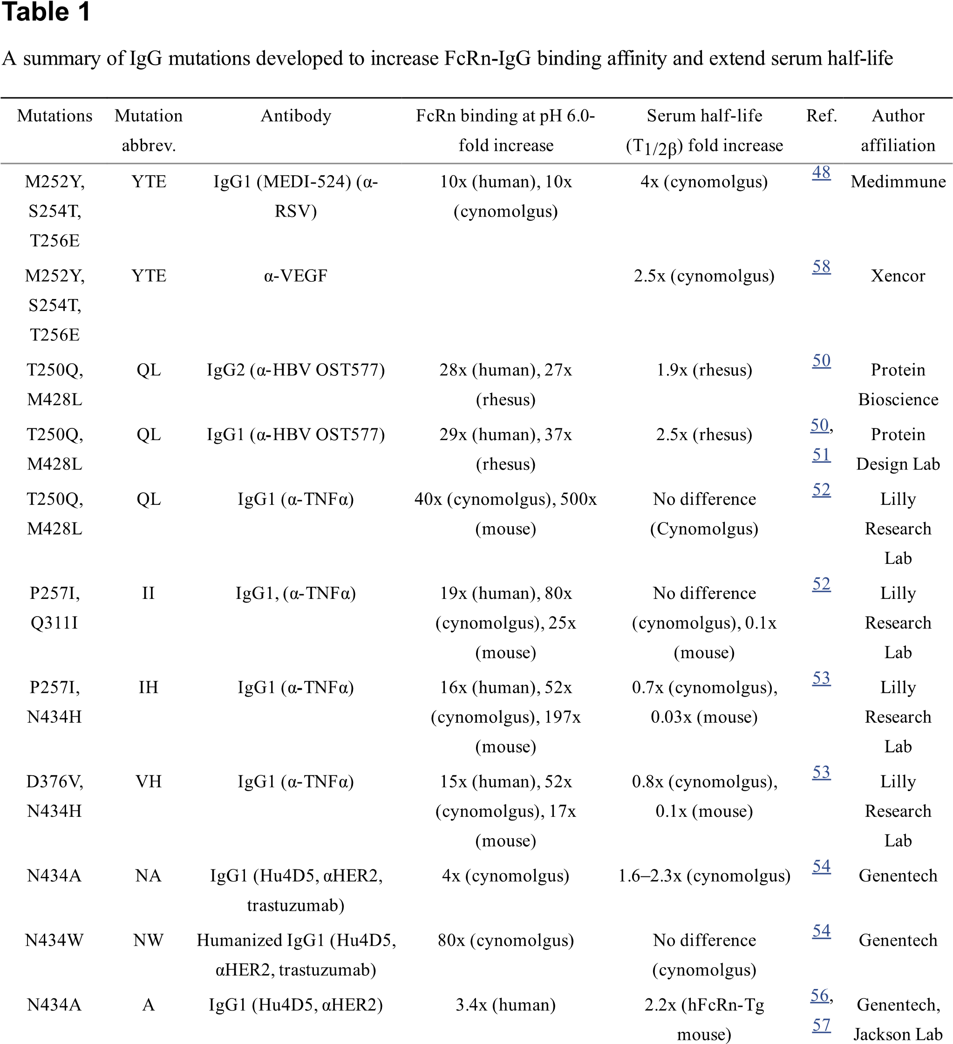
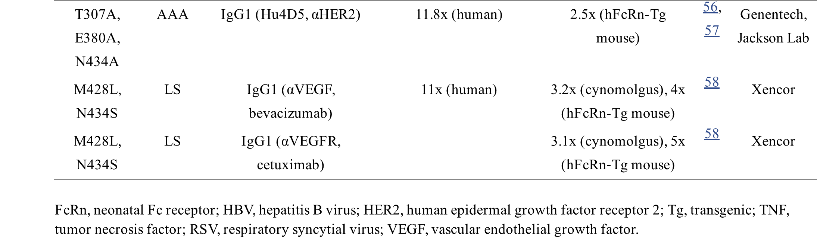
How can we improve PK of IgG ?
Most people answered like this …
Increasing binding activities at low pH (~pH6.0) and decreasing binding activities at physiological pH ?
Top two antibodies
YTE (Medimmune): 2.5-4 fold increase in cynomolgus
LS (Xencor): 3 fold increase in cynomolgus

Slide 4
K_{D} at pH6.0 and pH7.4: Is it equally important?
Yes.
- LS and YTE showed 10-20 fold increased KD at pH6.0 and similar KD at pH7.4 comparing with WT IgG. And they showed 4-5 fold enhanced PK in hFcRn-TG mice.
No.
Ratio of two K_{D}s is not strongly correlated with PK of engineered IgG variants.
Datta-Mannan et al., 2007 and 2012, Zheng et al., 2011, and Borrok et al., 2014)
Stronger correlation with koff rate when pH changes from 6 to 7.4
Weirong Wang et al., 2011 Drug Metabolism and Disposition

Slide 5
Is Current method proper to evaluate KD of IgG at pH7.4 ?
Xencor and Medimmune are insisting that LS and YTE has comparable binding activities at pH 7.4. REALLY ?
SPR analysis with highly immobilized FcRn (Benjamin T. Walters et al., 2015 JBC)
YTE
WT
4000 RU

Slide 6
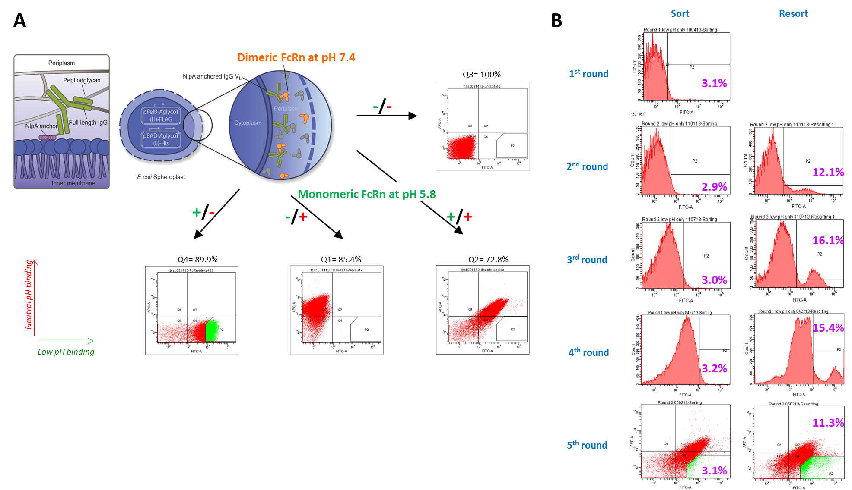
Screening strategy
Giving pH-dependent Binding properties
Lowering affinity at neutral pH

Slide 7
Isolated Fc candidates showed enhanced FcRn binding properties
By THK
50 nM dFcRn-rPE at pH 7.4
M 236.62
M 60.26
M 379.27
M 20.40
M 83.27
10 nM sFcRn-FITC at pH 5.8
M 18.58
M 231.42
M 239.43
M 265.38
M 134.82
M 152.46
A231T/V264E/L309D/Q311H/N434Y
M 51.83
V264E/L309D/Q311H/N434S
V264E/L309D/Q311H/N434Y
V264E/L309D/Q311H
M428L/N434S
Events
Wild-type
 | 10 nM of scFcRn-Alexa488 at pH5.8 |  | 50 nM of dFcRn-GST-Alexa647 at pH7.4
IgG1 | 51.83 | 1.00 | 18.58 | 1.00
M428L/N434S | 152.46 | 2.94 | 83.27 | 4.48
V264E/L309D/Q311H | 134.82 | 2.60 | 20.40 | 1.10
V264E/L309D/Q311H/N434Y | 265.38 | 5.12 | 379.27 | 20.41
V264E/L309D/Q311H/N434S | 239.43 | 4.62 | 60.26 | 3.24
A231T/V264E/L309D/Q311H/N434Y | 231.42 | 4.46 | 236.62 | 12.74
A231T/V264E/L309D/Q311H/N434Y
V264E/L309D/Q311H/N434S
V264E/L309D/Q311H/N434Y
V264E/L309D/Q311H
M428L/N434S
Wild-type

Slide 8
EDHS showed better binding properties than WT
By THK
SPR analysis at pH5.8
ELISA with GST-tagged FcRn at pH7.4
Herceptin
Herceptin-EDHS
Response Units (RU)
Response Units (RU)
Absorbance at 450nm
Time (sec)
Time (sec)
Concentration of dFcRn (nM)
K_{D} at pH 5.8
 | K_{on} (10⁵ M⁻¹ sec⁻¹) | K_{off} (10⁻² sec⁻¹) | K_{D} (nM)
Herceptin | 5.4 ± 0.30 | 29 ± 0.85 | 550 ± 46
Herceptin-LS | 6.2 ± 1.6 | 3.3 ± 0.07 | 55 ± 3.2
Herceptin-EDHS | 12 ± 1.3 | 11 ± 1.0 | 93 ± 1.3

Slide 9
EDHS showed better binding properties for FcRn but…
EDHS lost FcγRs-binding activities….
FcγRI-his
FcγRIIa_{H131}-GST
FcγRIIa_{R131}-GST
WT
EDHS
Absorbance at 450 nM
Absorbance at 450 nM
Absorbance at 450 nM
Receptor concentration (nM)
Receptor concentration (nM)
Receptor concentration (nM)
FcγRIIb-GST
FcγRIIIa_{V158}-GST
FcγRIIIa_{F158}-GST
Absorbance at 450 nM
Absorbance at 450 nM
Absorbance at 450 nM
Receptor concentration (nM)
Receptor concentration (nM)
Receptor concentration (nM)

Slide 10
EDHS showed better binding properties for FcRn but…
By CHL
V264E induces the heterogenic glycosylation of Fc domain so IgG V264 lost the binding activities for FcγRs.
Herceptin-DHS (pH5.8)
ELISA with GST-tagged FcRn at pH7.4
Removal of V264E mutation from EDHS ?
 | K_{D} (nM)
Herceptin | 550 ± 46
Herceptin-LS | 55 ± 3.2
Herceptin-EDHS | 93 ± 1.3
Herceptin-DHS | 111 ± 20

Slide 11
Removal of V264E mutation recovers FcγR-binding activities
FcγRI-his
FcγRIIa_{H131}-GST
FcγRIIa_{R131}-GST
WT
DHS
EDHS
Absorbance at 450 nM
Absorbance at 450 nM
Absorbance at 450 nM
Receptor concentration (nM)
Receptor concentration (nM)
Receptor concentration (nM)
FcγRIIb-GST
FcγRIIIa_{V158}-GST
FcγRIIIa_{F158}-GST
Absorbance at 450 nM
Absorbance at 450 nM
Absorbance at 450 nM
Receptor concentration (nM)
Receptor concentration (nM)
Receptor concentration (nM)

Slide 12
DHS showed comparable effector functions with WT
Cancer cell: SkBR3
E:T ratio: 40:1 (ADCC) 10:1 (ADCP)
Donor genotype: H/R V/F
By CHL and GD
ADCC
ADCP
Isotype control
Herceptin
DHS
Isotype control
Herceptin
DHS
% of tumor cell lysis
% of phagocytosis
10 ug/ml
3.3 ug/ml
1.1 ug/ml
20 ug/ml
5 ug/ml
1.25 ug/ml

Slide 13
DH lowers the binding activity of Fc variant to FcRn at neutral pH
By CHL
Binding of Fc variants at pH 7.4
K_{D} values of Fc variants at pH 5.8
Herceptin
DHS
N434S
LS
 | K_{on} (10⁵ M⁻¹ sec⁻¹) | K_{off} (10⁻² sec⁻¹) | K_{D} (nM)
Herceptin | 5.4 ± 0.30 | 29 ± 0.85 | 550 ± 46
Herceptin-DHS | 7.77 ± 0.24 | 8.7 ± 0.09 | 111 ± 20
Herceptin-N434S | 4.6 ± 2.2 | 8.8 ± 0.25 | 220 ± 110
Absorbance at 450 nm
dFcRn concentration (nM)

Slide 14
SPR analysis with three different densities of shFcRn at pH 7.4
WT
DHS
LS
YTE
Rough radius of FcRn: 2 nm
Rough radius of IgG: length of one arm: ~ 10nm
CM5 chip
1 RU=1 pg/mm²=0.01 mg/ml
*Low density: 0.5 ng/mm²= 5 mg/ml (167 uM) -> 21.4 nm between each FcRn
*Medium density: 2 ng/mm²-> 13.5 nm between each FcRn
*High density: 5 ng/mm²-> 9.9 nm between each FcRn
Low density
Response unit (RU)
Response unit (RU)
Response unit (RU)
Response unit (RU)
Time (sec)
Time (sec)
Time (sec)
Time (sec)
Medium density
Response unit (RU)
Response unit (RU)
Response unit (RU)
Response unit (RU)
Time (sec)
Time (sec)
Time (sec)
Time (sec)
High density
Response unit (RU)
Response unit (RU)
Response unit (RU)
Response unit (RU)
So, medium and high density of FcRn condition can provide 2:1 binding on the chip.
Table for K_{D}s
Time (sec)
Time (sec)
Time (sec)
Time (sec)
FcRn level | Herceptin | DHS | LS | YTE
Low | - | - | - | -
Medium | - | - | 58.7 nM | 4.73 uM
High | - | - | 22.7 nM | 4.29 uM

Slide 15
pH-dependent binding activities of each Fc variants.
Low density
Medium density
High density
WT
DHS
LS
YTE
Response unit (RU)
Response unit (RU)
Response unit (RU)
pH
pH
pH
Table of pH₅₀.
 | WT | DHS | LS | YTE
Low | 6.37 | 6.28 | 6.36 | 6.29
Medium | 6.35 | 6.27 | 6.40 | 6.30
High | 6.33 | 6.29 | 6.52 | 6.40

Slide 16
Pharmacokinetics of DHS
Mouse model: hemizygous hFcRn transgenic mice (line 276)
Repeated three times and total N=11
IgG concentration (μg/ml)
WT
DHS
LS
YTE
Days
 | Clearance (ml/days/kg) | β phase T_{1/2} (hrs) | AUC_{inf.} (μg*days/ml) | Vss (ml/kg)
Wild-type | 0.58 ± 0.17 | 49.3 ± 8.8 | 41.2 ± 23.6 | 1.11 ± 0.15
DHS | 0.061 ± 0.003 | 336 ± 49.5 | 326.6 ± 17.9 | 0.28 ± 0.01
LS | 0.099 ± 0.004 | 107 ± 14.3 | 200.7 ± 9.4 | 0.34 ± 0.01
DHS | 0.111 ± 0.028 | 204.3 ± 17.4 | 178.7 ± 12.5 | 0.42 ± 0.01

Slide 17
Pharmacokinetics of DHS - 2
Ophelie in PB group
Audrey (hFcγRs)
Audrey-gammaprim-hCk (hFcγR + hIgG1)
Nancy (hFcγR + hFcRn)
Marlene (hFcγR + hFcRn + hβ2m)
Scarlett (hFcγR + hFcRn + hβ2m + hIgG1)
 |  | Clearance (ml/days/kg) | β phase T_{1/2} (hrs) | AUC_{inf.} (μg*days/ml) | Vss (ml/kg)
Scarlet | Wild-type | 0.133 ± 0.018 | 101.1 ± 11.4 | 161.0 ± 11.4 | 0.40 ± 0.06
 | DHS | 0.028 ± 0.001 | 323.0 ± 24.1 | 707.2 ± 10.6 | 0.14 ± 0.01
 | YTE | 0.041 ± 0.004 | 294.7 ± 17.8 | 494.5 ± 37.5 | 0.21 ± 0.02
 | LS | 0.047 ± 0.005 | 284.1 ± 9.7 | 438.0 ± 43.4 | 0.24 ± 0.02
Marlene | Wild-type | 0.079 ± 0.002 | 148.9 ± 14.3 | 250.6 ± 7.6 | 0.32 ± 0.01
 | DHS | 0.017 ± 0.001 | 417.9 ± 24.0 | 1200.8 ± 25.2 | 0.10 ± 0.01
 | YTE | 0.023 ± 0.001 | 412.3 ± 22.6 | 864.6 ± 23.6 | 0.14 ± 0.01
 | LS | 0.033 ± 0.001 | 359.9 ± 30.5 | 600.0 ± 23.1 | 0.21 ± 0.01
 | WT | DHS | LS | YTE
Audrey gamma | 5.40 | 7.36 | 7.09 | 5.88
Audrey | Need more time points
Nancy

Slide 18
Pharmacokinetics of DHS - 2
Ophelie in PB group
Scarlett (n=6) (hFcgR + hFcRn + hb2m + hIgG1)
Marlene (n=5) (hFcgR + hFcRn + hb2m)
Nancy (n=1) (hFcgR + hFcRn )
Audrey-gammaprim-hCk (n=5) (hFcgR + hIgG1)
Audrey (n=5) (hFcgR)
X axis: Time (hrs)
Y axis: Antibody concentration (ug/ml)

Slide 19
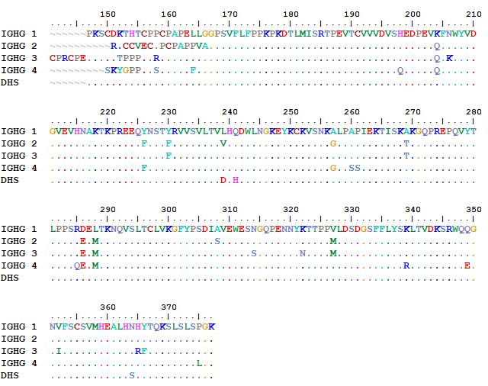
DHS in IgG subclasses
FcRn-binding sites are conserved in IgG subclasses
FcRn binding sites
IgG1,2,4: ~ 3 weeks
IgG3-R435: ~ 8 days
IgG3-H435: ~ 3 weeks

Slide 20
DHS in IgG subclasses
1) FcRn binding activities
IgG2
IgG3
IgG4
Response unit (RU)
Response unit (RU)
Response unit (RU)
Time (sec)
Time (sec)
Time (sec)
IgG2-DHS
IgG3-DHS
IgG4-DHS
Response unit (RU)
Response unit (RU)
Response unit (RU)
Time (sec)
Time (sec)
Time (sec)

Slide 21
DHS in IgG subclasses
1) FcRn binding activities
 | K_{on} (10⁵ M⁻¹ sec⁻¹) | K_{off} (10⁻² sec⁻¹) | K_{D} (nM)
Herceptin-IgG2 |  |  | 2140 ± 380
Herceptin-IgG2-DHS | 2.27 ± 0.13 | 8.6 ± 0.1 | 377 ± 26 (5.7)
Herceptin-IgG3 |  |  | 4080 ± 790
Herceptin-IgG3-DHS | 1.7 ± 0.13 | 12.6 ± 0.3 | 739 ± 75 (5.5)
Herceptin-IgG4 |  |  | 2460 ± 165
Herceptin-IgG4-DHS | 2.81 ± 0.10 | 15.1 ± 0.2 | 832 ± 16 (3.0)

Slide 22
DHS in IgG subclasses
2) FcγRs binding activities
Y axis: Absorbance at 450 nm

Slide 23
DHS in IgG subclasses
3) PK properties
IgG concentration (μg/ml)
WT IgG2
DHS-IgG2
WT IgG4
DHS-IgG4
Days
 | Clearance (ml/days/kg) | β phase T_{1/2} (hrs) | AUC_{inf.} (μg*days/ml) | Vss (ml/kg)
Wild-type | 0.13 ± 0.02 | 68.0 ± 7.5 | 77.5 ± 5.6 | 0.87 ± 0.11
DHS | 0.067 ± 0.015 | 199.8 ± 4.9 | 148.3 ± 7.5 | 0.57 ± 0.02
LS | 0.16 ± 0.03 | 76.8 ± 9.4 | 62.4 ± 8.3 | 1.0 ± 0.1
DHS | 0.067 ± 0.048 | 277.4 ± 14.9 | 149.2 ± 6.3 | 0.58 ± 0.03

Slide 24


Slide 25
Acknowledgements
BIGG group
Pasteur Institute
Prof. George Georgiou
Prof. Gregory C. Ippolito
Prof. Pierre Bruhns
Ophelie Gordon
Dr. Makiko Watanabe
Dr. Taehyun Kang
George Delidakis
Jiwon Lee
Yuri Tanno
All BIGG lab members

